Slide 1
SmartCalc - Calculator, Converter, BMI Measurement
An iOS Application
Developed for Mobile Computing Laboratory (CSE 3218)
Presentation By –
Bishal Roy 2007098
Faiyaz Mahmud 2007103
Dipto Saha 2007119

Slide 2
Features
User authentication
A simple yet useful calculator
Unit converter
BMI measurement with health warning

Slide 3
Technical Implementation
User interface - SwiftUI
User authentication - Firebase Authentication
User data storage - Firestore Database
Unit conversion API - Rapid API
IDE Used - XCode

Slide 4
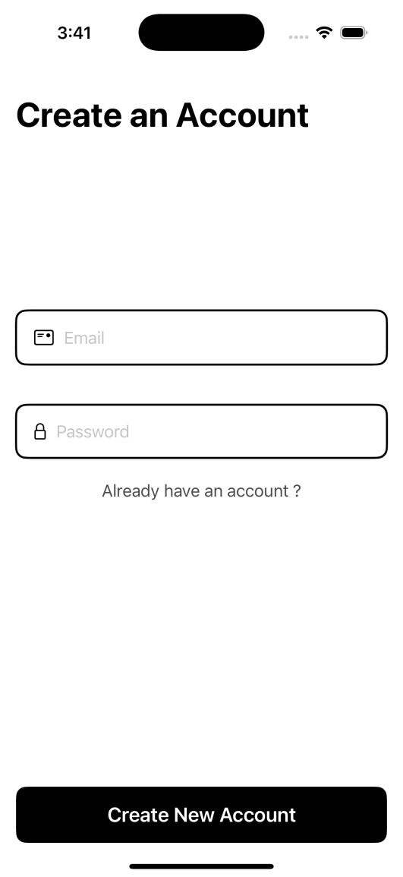
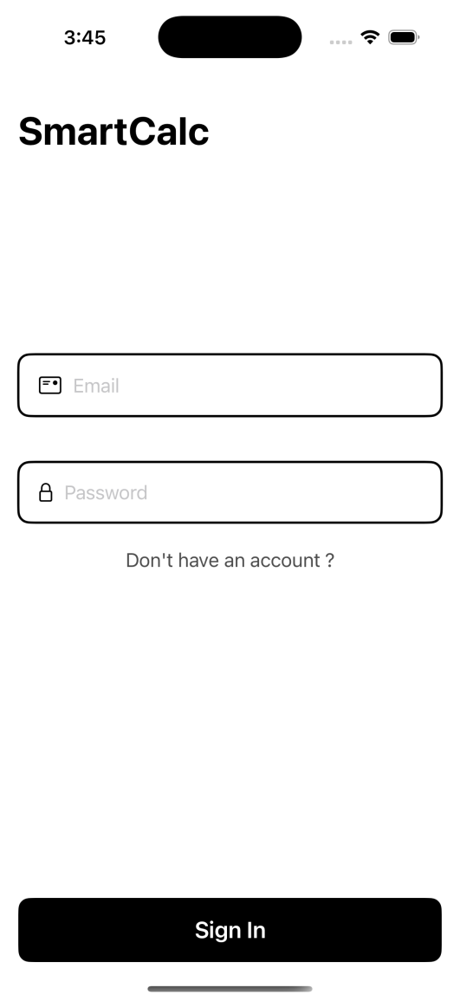
Sign Up, Sign In, Sign Out
User Authentication
Firebase Authentication is used for authentication.
Sign up and sign in with email and password.
Sign out functionality.

Slide 5
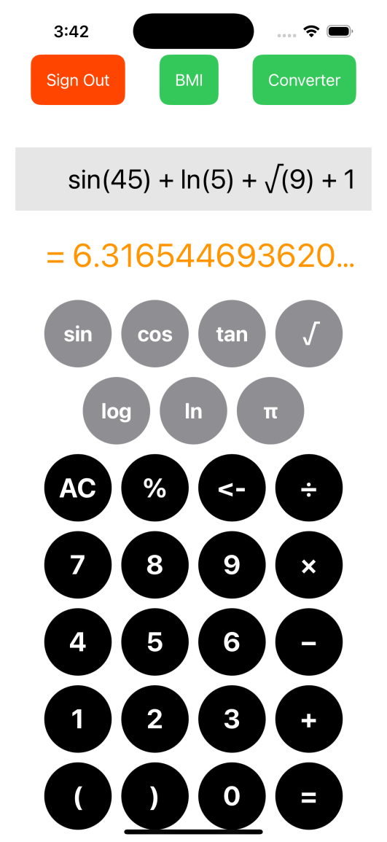
Calculate BMI, Convert Units & Do Math
Home Page
SwiftUI is used to design user interface.
Sign up and sign in with email and password.
Sign out functionality.

Slide 6
Mathematical Operation Using a Simple Calculator
Calculator
Normal arithmetic operation.
sin, cos, tan, log, ln, square, square root functionality.

Slide 7
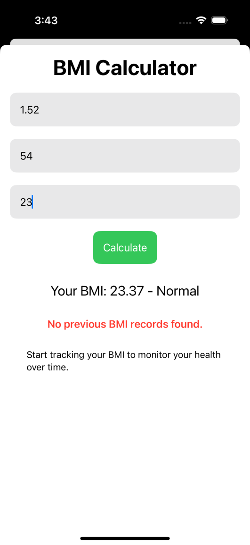
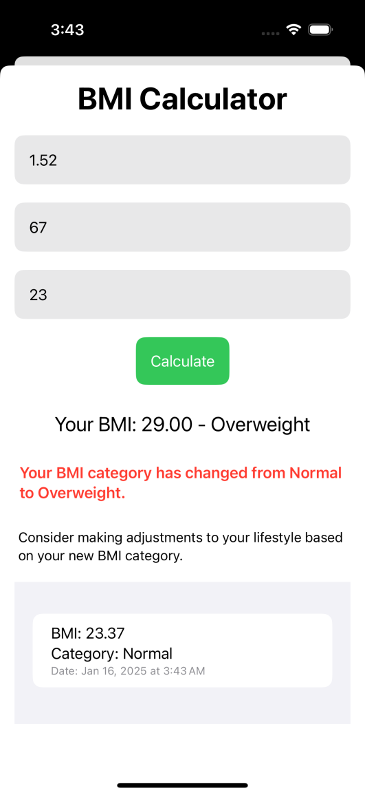
BMI Calculation With Health Warning
BMI Calculator
Firebase Firestore is used to store user data.
Calculates BMI.
Compares with previous data to provide update and health warning.

Slide 8
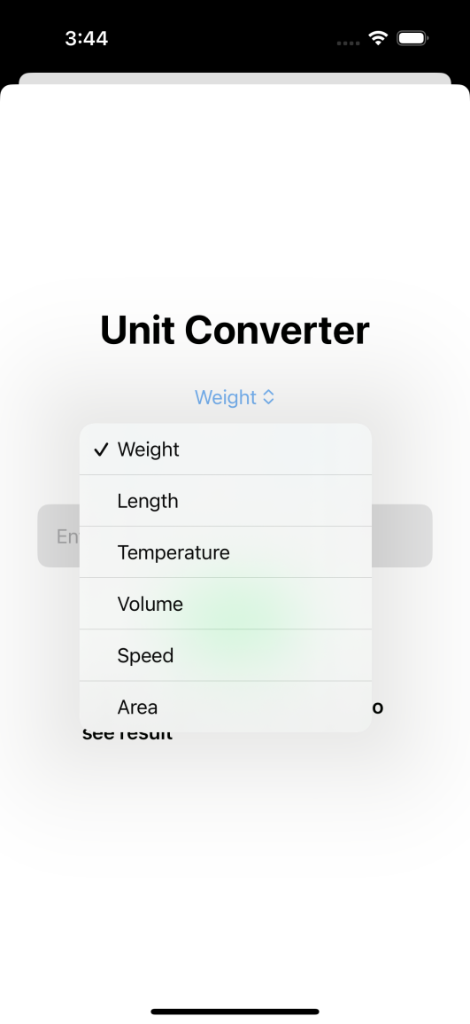
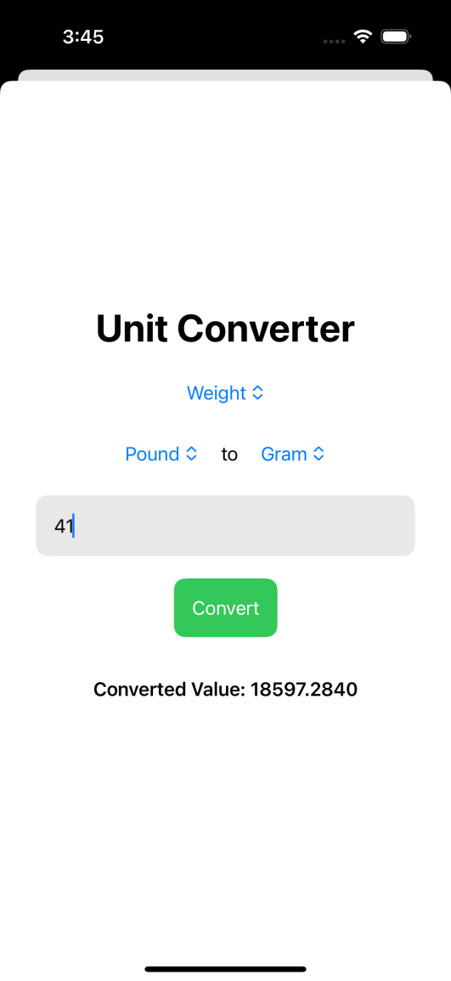
Unit Conversion Using API
Unit Converter
API provided by Rapid API.
Converts weight, length, temperature, volume, area and speed.

Slide 9
Thank You !
Presented By –
Bishal Roy 2007098
Faiyaz Mahmud 2007103
Dipto Saha 2007119

